Slide 1
CSE225 - Data Structures and Algorithms
Array
Mosroor Mofiz Arman
1921079642
Section: 4

Slide 2
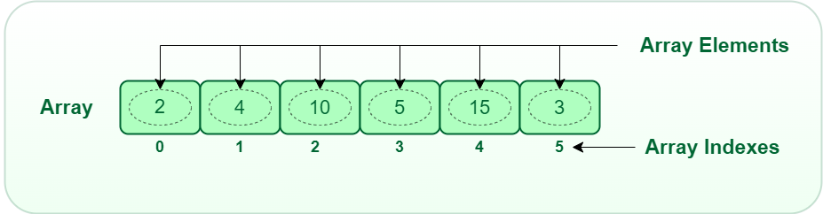
Array
Same data type stored at contiguous memory locations.

Slide 3
Declaring and Initializing Arrays
Declaring Array
data_type array_name[SIZE];
Example:
int ar_name[10] ];
Initializing Array
one by one –
int ar[5];
ar[0]=10; ar[1]=20;
using a single statement–
double balance[5] = {1000.0, 2.0, 3.4, 7.0, 50.0};

Slide 4
Address of the Array elements
Formula-
array_address + element_size × (i − first_index)
Example
What is the address of the element at index 4 if address is 1000, element size is 8 and first index is 0?
array_address + element_size × (i − first_index)
= 1000 + 8 × ( 4 - 0 )
=
1032

Slide 5
Multi-Dimensional Arrays
Formula-
array_address + element_size × [(i − first_index) × column number + (j − first_index)]
Example
What is the address of the element at index (2,3) if address is 1000, element size is 36 and first index is (1,1)?
array_address + element_size × [(i − first_index) × column number + (j − first_index)]
= 1000 + 36 × [( 2 - 1 ) × 6 + ( 3 - 1 ) ]
=
1288

Slide 6
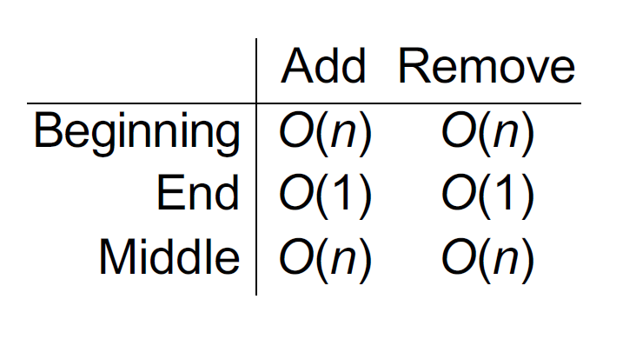
Time for Common Operations

Slide 7
Thank You

